Slide 1


Star Stare
Sheba Game Jam
A game that turns a vestibular exam into a fun experience for kids
Nurit Michelson Hadas Ben Rubi Shimron Hillel Zekri Idan Bar
Batya Bracha Hed Gilboa Tomer Chazan Amir Blum Ribi Hlperin
Notes:
Opening: introduce the team and the game – Star Gaze, a computer game that helps kids get through a vestibular exam while having fun.

Slide 2





The world spins – even when you’re standing still
Vestibular vertigo in a nutshell
A balance problem in the inner ear
Dizziness, falling, nausea
Eyes may jump: nystagmus
Notes:
Short version: vestibular vertigo is a spinning feeling caused by a problem in the inner ear’s balance system. Kids may feel dizzy, fall or feel sick – and their eyes may make jerky movements called nystagmus, which is what the doctor looks for during the exam.

Slide 3
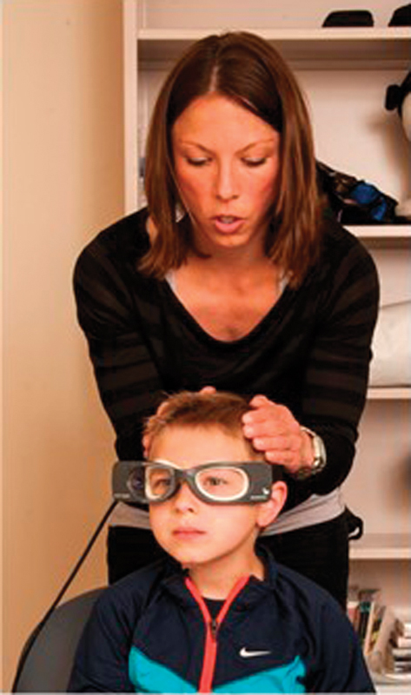
What the exam looks like
The child sits in front of the screen and focuses on the pen, while the doctor gently moves the head and watches the eyes.
Eyes on the pen, head in motion
Notes:
Illustration of the exam: the child looks at the happy star on screen while the doctor gently moves his head and watches his eyes.

Slide 4



Keeping a steady gaze? For kids, that’s really hard
The challenge
Fear and stress
Hard to focus
Less accurate exam
A strange room, a doctor and equipment – the child just wants to go home
Staring at one spot while someone moves your head is boring and confusing
When the gaze drifts off target, eye movements are harder for the doctor to read
Notes:
A vestibular exam asks the child to keep looking at one point while the doctor moves their head. Kids get scared, bored and lose focus – and that hurts the quality of the exam.

Slide 5

What if the exam was a game?
Instead of “look there and don’t move” – “help the star stay happy!”
Notes:
The core idea: turn the medical task into a game mission. The child isn’t being “tested” – they’re keeping the star happy.

Slide 6
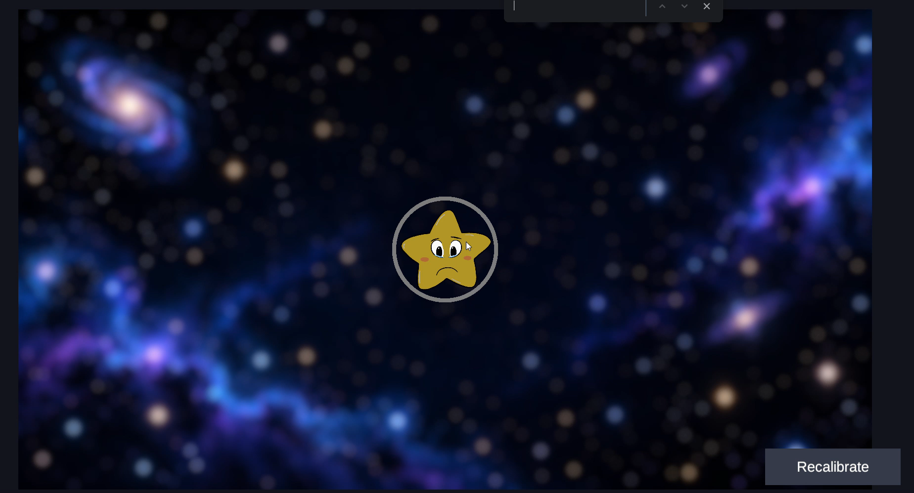

Slide 7


The star reacts to the child’s gaze
The heart of the game
Looking? The star is happy!
Looked away? The star is sad
A big smile and fun music – the child knows they’re doing great
Happy music is playing
A sad face and The music stops– a gentle cue to look back
.
Notes:
Instant feedback: when the child looks at the star, it smiles and fun music plays. When the gaze drifts, the star turns sad and the music too – so the child figures out on their own to look back. No instructions, no scolding.

Slide 8

How does it work? 3 simple steps
The game
1
2
3
The child looks at the star
The doctor moves the head
The doctor checks the eyes
A star in the middle of the screen. The mission: don’t take your eyes off it
Gentle head movements while the child stays focused on the star
Is there nystagmus, and how fast are the eyes moving?
Notes:
Three steps: the child focuses on the star, the doctor moves the head, and the doctor watches the eyes – looking for nystagmus and checking eye movement speed.

Slide 9



Everybody wins
Who benefits?
The child
The doctor
The parents
A familiar, fun game instead of a scary exam – and a feeling of success
A focused child whose gaze stays on target – an easier, clearer exam
A calm, happy child and an exam that ends with a smile
Notes:
Benefits for everyone involved: the child has fun, the doctor gets better cooperation, and the parents see a calm child.

Slide 10




The star’s next level
Ideas for the future
Using head tracking for Vestibular treatment
Matching characters and environments for different ages
Measuring how much the game improves the exam
Taking the treatment game home
Notes:
Possible next steps – adjust to the team’s plans.

Slide 11

Thank you!
Questions? The star is waiting 😊
Notes:
Closing and thanks. Replace the team member names.

